Slide 1
Oral Health for Parents
Richmond Preschool CIC
© Early Years Staffroom.com Ltd

Slide 2
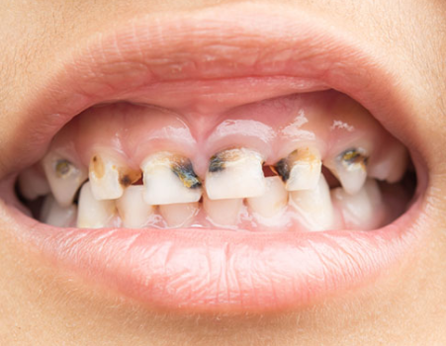
Why is oral health so important?
Tooth decay is the number 1 reason that children
aged 5-9 are admitted to hospital!
23,529 children underwent hospital treatment for tooth decay from April 2019 to March 2020. This is more than double the second most common cause, acute tonsilitis!
© Early Years Staffroom.com Ltd

Slide 3
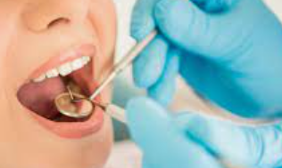
When should we take our first trip to the dentist?
At 6 months then every 6 months
© Early Years Staffroom.com Ltd

Slide 4
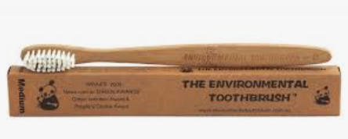
How to keep your child’s teeth healthy
Teach your child how to clean their teeth at least twice a day, you will need to support this until they are 10.
Eat a well-balanced diet that limits starchy or sugary foods.
Make sure that your child is drinking water or using dental products with the appropriate level of fluoride.
Take your child to the dentist for regular check-ups and preventive care.
Visit the dentist right away if an injury has led to chipped, broken, or knocked-out teeth.
© Early Years Staffroom.com Ltd

Slide 5
Why do you need fluoride?
Over time, we have become increasingly aware of the important role of fluoride in strengthening tooth enamel. Fluoride occurs naturally in some water supplies, but in other parts of the country it is added to prevent dental decay. Research has shown that there is substantially less dental decay in children’s teeth in areas where the drinking water is fluoridated.
© Early Years Staffroom.com Ltd

Slide 6
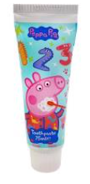
How should you brush children’s teeth?
Use fluoride toothpaste appropriate for their age – a pea sized amount
At a 45 degree angle brush where the gum meets the teeth gently all around
Spit out the toothpaste
Brush twice a day for 2 minutes
© Early Years Staffroom.com Ltd

Slide 7
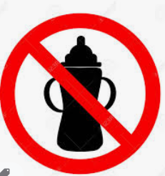
What else can I do?
Stop using baby bottles at 12 months as drinking from a bottle rather than a cup or beaker may encourage dental cavities in children, as the natural milk sugars present often linger around the teeth for longer with the use of the bottle.
© Early Years Staffroom.com Ltd

Slide 8
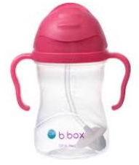
What else can I do?
Only drink water at night as this cannot effect teeth.
© Early Years Staffroom.com Ltd

Slide 9
What else can I do?
Avoid sugary foods and drinks.
© Early Years Staffroom.com Ltd

Slide 10
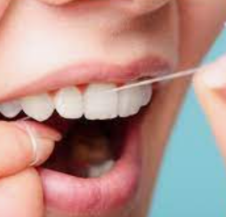
What else can I do?
Help floss your child’s teeth from aged 2-3.
© Early Years Staffroom.com Ltd

Slide 11
More Information
https://teethteam.org.uk/resources/BSPD-Practical-parenting-guide.pdf
© Early Years Staffroom.com Ltd

